Slide 1
RADDOSE-3D Tutorial
Tutorial Task: TEST our new GUI, written by Joshua Dickerson
jdickerson@mrc-lmb.cam.ac.uk
To run RADDOSE-3D for MX, SMX or SAXS (which ever you like!)
Step 1: Download and unzip the RADDOSE-3D GUI from:
https://github.com/jdickerson95/qt_RADDDOSE-3D/releases
There are versions for a PC (Windows_release.zip) and for Linux (Linux_release.zip).
If you have a MAC, there is no new GUI yet, but you can run a limited capability RADDOSE-3D from the WWW site:
raddo.se
(click on ‘manual interface’ and run the test example first. Then edit the input for a case you would like to try)
To run the GUI you need to have Java installed which you can get free at
https://www.java.com/download/ie_manual.jsp
Also, if you have R (https://www.r-project.org/) installed, from the RADDOSE-3D output you will be able to produce 3D representations of the dose distribution in your sample.

Slide 2
Step 2: Unzip the file you have downloaded. On Windows machines I recommend the best place to install the executable (e.g. Documents versus Program Files) is in Documents as I tend to avoid putting programs in Program Files unless I am using an installer, to avoid the need for admin privileges and to keep things self-contained.
Note that installing a third party executable by direct download rather than through an installer might lead to your antivirus software complaining.

Slide 3
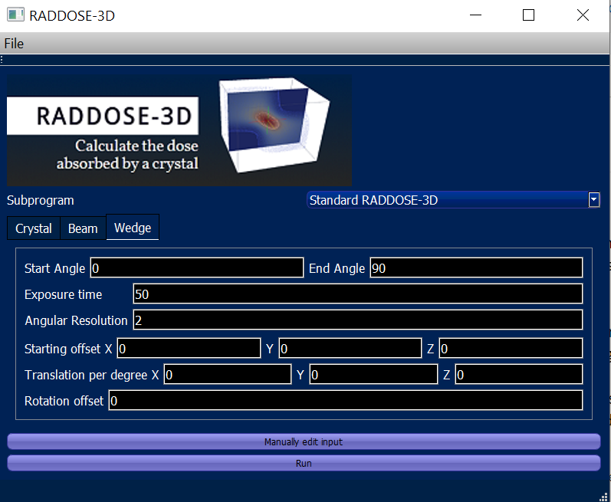
Step 3: Find the file RD3D_GUI.EXE and if on a PC click on it. For Linux run it however you usually run executable files. The GUI should open, and you can enter input on 3 tabs: crystal, beam and wedge. I will talk you through these during the tutorial.

Slide 4
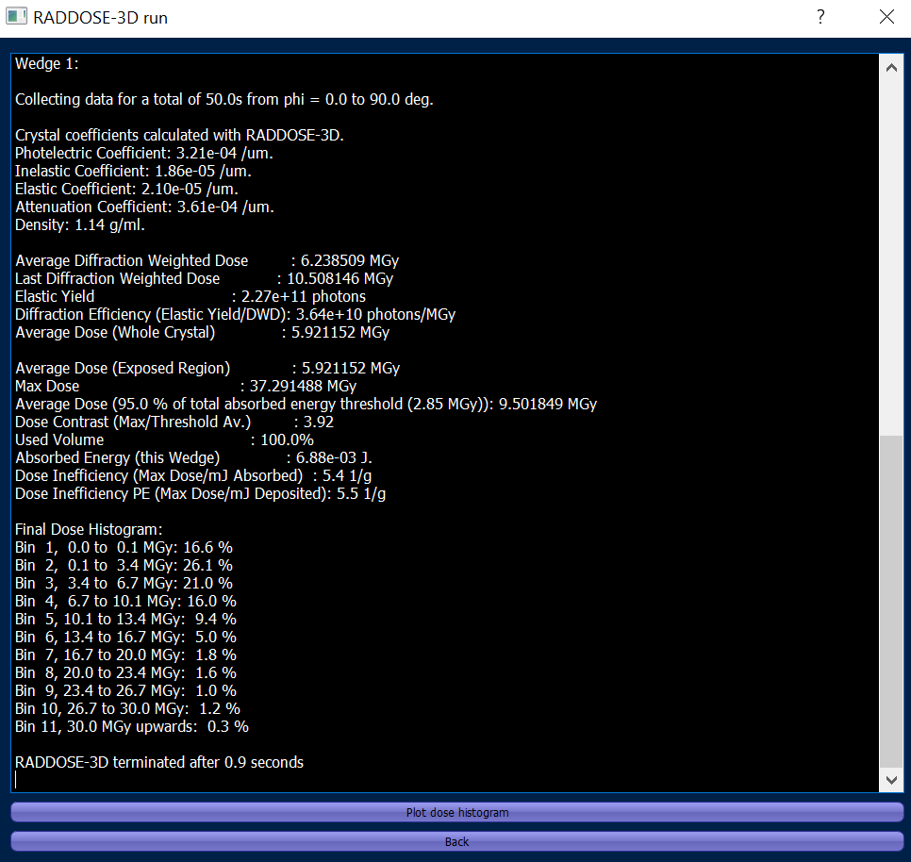

Slide 5
Step 4: Understanding the output! DOSE = ENERGY/MASS
Photoelectric Coefficient: 6.35e-04 /um.
Inelastic Coefficient: 1.87e-05 /um.
Elastic Coefficient: 2.36e-05 /um.
Attenuation Coefficient: 6.77e-04 /um.
Density: 1.16 g/ml.
Average Diffraction Weighted Dose : 11.887135 MGy
Last Diffraction Weighted Dose : 20.040846 MGy
Elastic Yield : 2.51e+11 photons
Diffraction Efficiency (Elastic Yield/DWD): 2.11e+10 photons/MGy
Average Dose (Whole Crystal) : 11.271797 MGy
Average Dose (Exposed Region) : 11.271797 MGy
Max Dose : 71.040785 MGy

Slide 6
Step 4: Understanding the output! DOSE = ENERGY/MASS
Average Dose (95.0 % of total absorbed energy threshold (5.36 MGy)): 18.088188 MGy
Dose Contrast (Max/Threshold Av.) : 3.93
Used Volume : 100.0%
Absorbed Energy (this Wedge) : 1.33e-02 J.
Dose Inefficiency (Max Dose/mJ Absorbed) : 5.3 1/g
Dose Inefficiency PE (Max Dose/mJ Deposited): 5.5 1/g
NB: some dose is escaping with photoelectrons emerging from crystal so Max dose/energy absorbed is less than Max dose/energy deposited)

Slide 7
RADDOSE-3D References
1) RADDOSE-3D: time- and space-resolved modeling of dose in macromolecular crystallography. Oliver B. Zeldin, Markus Gerstel and Elspeth F. Garman. Journal of Applied Crystallography (2013) 46, 1225-1230.
2) Predicting the X-ray lifetime of protein crystals. Oliver B. Zeldin, Sandor Brockhauser, John Bremridge, James Holton and Elspeth F. Garman.
PNAS (2013) 110, 20551-20556
3) Development of tools to automate quantitative analysis of radiation damage in SAXS experiments. Jonathan C. Brooks-Bartlett, Rebecca A. Batters, Charles S. Bury, Edward D. Lowe, Helen Mary Ginn, Adam Round and Elspeth F. Garman.
J. Synchrotron Radiation (2017) 24, 63–72. doi:10.1107/S1600577516015083
4) Estimate your dose: RADDOSE-3D. Charles S. Bury, Jonathan C. Brooks-Bartlett, Steven P. Walsh & Elspeth F. Garman. Protein Science (2018) 27, 217–228
5) Radiation damage in small molecule crystallography: fact not fiction.
Jeppe Christensen, Peter N. Horton, Charles S. Bury, Joshua L. Dickerson, Helena Taberman, Elspeth F. Garman*, Simon J. Coles*. IUCrJ (2019) 6, 703–713
6) Doses for experiments with microbeams and microcrystals :Monte Carlo simulations in RADDOSE-3D. Joshua L. Dickerson and Elspeth F. Garman. (2021)
Protein Science. 30, 8–19.
7) RADDOSE-XFEL: Femtosecond time-resolved dose estimates for macromolecular XFEL experiments. Joshua L. Dickerson, Patrick T.N. McCubbin and Elspeth F. Garman.
J. Appl. Cryst. (2020). 53, 549–560 https://doi.org/10.1107/S1600576720000643

